Slide 1

Predicting Road Accident Severity Using Machine Learning Models
A Case Study on the United Kingdom
Zoltan Hradszky
September 30, 2020

Slide 2
About the project
In 2016, there were 1.35 million traffic deaths globally, and traffic accidents became the leading cause of death for children and young adults in the past decade (WHO)
The UK ranks among the safest countries to drive, but the number of traffic deaths haven’t decreased since 2010
The project used road accident statistics from the United Kingdom to predict accident severity based on a selection of features
The features include drivers’ characteristics, casualty behavior and environmental factors, such as weather, road surface conditions, etc.
The project evaluated two commonly used machine learning models, namely the Support Vector Machine (SVM) and the Classification Tree

Slide 3

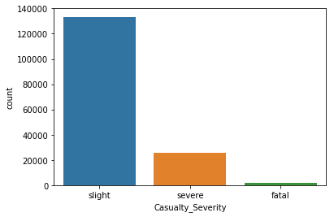
Accident Severity
There were 122 thousand reported road accidents in the UK with 25 thousand people severely injured and 1,784 deaths
From an analytical perspective, the distribution of the data is skewed and it is difficult to describe the circumstances of accident severity with linear models
For the sake of easier interpretation, and later model development, severe and fatal accidents were merged into one category

Slide 4
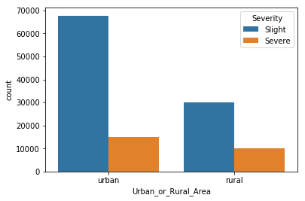
Urban and rural areas
There is no single factor that could predict a road accidents, but a number of them have a greater impact on the accident outcome
Casualties in rural road accidents are 2x more likely get severely or fatally injured than those in urban areas
This is explained by higher speed limits, lower traffic and fewer physical barriers to protect vulnerable road users

Slide 5
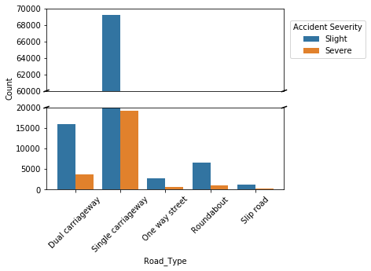
Accidents by road type
This figure shows that while there are more accidents on single carriageway roads in general, they do not seem to be more lethal than others
However, most roads in cities are single carriageway roads, as well as in rural areas
Seeking a correlation with single carriageway roads and area type, it may reveal significant findings concerning the target variable

Slide 6
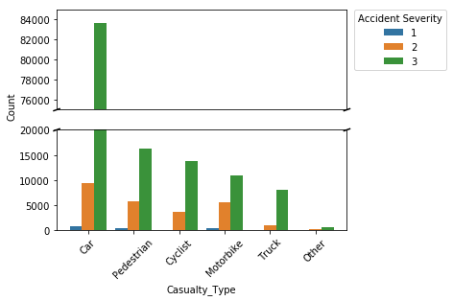
Casualty types
The most accidents occur among car passengers, but among other road users, such as pedestrians, cyclists and motorcyclists, a potential accident might be more likely severe of fatal than among other categories

Slide 7
Model development
The variables were transformed into binaries for the classification model
The sample skewedness was treated by balancing the sample between severe and slight accidents
The training set was reduced from 98,000 samples to 39,000 due to the balanced sampling and 25,000 samples were used for the test set
The feature variables were normalized using a standard scaler algorithm
Following the model training, it was evaluated on a test set, which was split from the original dataset and was not sampled using the imbalanced learn sampler

Slide 8
Model evaluation
The classification tree was selected as the best fit model, with a precision of 80% and a f1 score 0.88
The Support Vector Machine couldn’t accurately predict severe accidents; therefore, it was discarded due to the high number of both false positives and false negatives for the target variable (severe accident)

Slide 9
Potential applications
For the development of early warning system used by law enforcement and healthcare institutions
Installing safety features in newly manufactured cars
Further improved precautionary measures by road maintenance companies

